Slide 1
Image Pyramids and Wavelets for Multiscale Object Detection

Slide 2
The Need for Multiscale Representation
Objects in the real world appear at varying sizes in an image (e.g., a distant car vs. a close-up car).
Features that are prominent at one scale might be insignificant at another (e.g., fine texture vs. overall shape).
Traditional single-scale processing struggles with this variability.
Human Vision Inspiration: Our visual system inherently processes information hierarchically and at multiple resolutions.

Slide 3
Image Pyramids
Concept: A collection of images, all originating from a single original image, but successively downsampled to lower resolutions.
Provides a simple, intuitive multiscale representation.
Think of it as looking at the same scene from different distances.

Slide 4
Gaussian Pyramid Construction:
Step 1: Smoothing (Low-pass filtering): Apply a Gaussian filter to the image to reduce aliasing artifacts before downsampling.
Analogy: Blurring an image before shrinking it helps retain important features and prevents jagged edges.
Step 2: Downsampling: Reduce the resolution (e.g., by half, keeping every other row and column).
Iteration: Repeat steps 1 & 2 on the newly created smaller image to generate the next level of the pyramid.

Slide 5
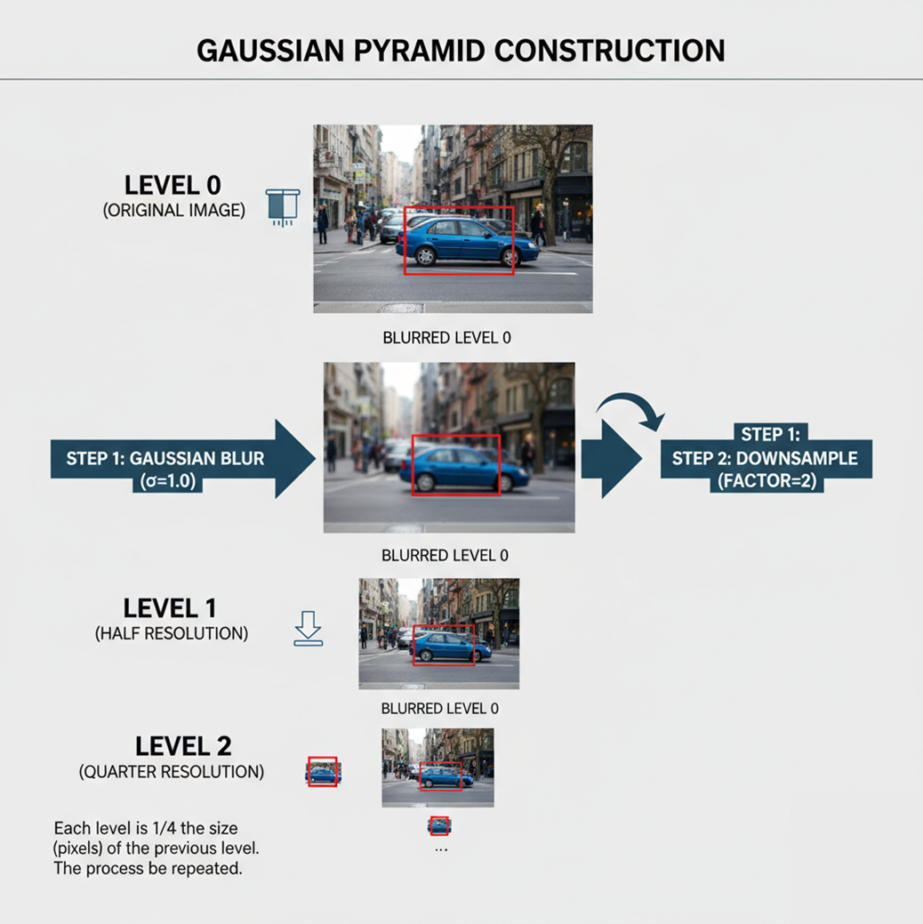
Illustration: Original image, then blurred and downsampled versions showing multiple levels of a Gaussian pyramid. `

Slide 6
Laplacian Pyramid Construction (Difference Pyramid):
Concept: Stores the "difference" information between successive levels of a Gaussian pyramid.
Process:
Take a level of the Gaussian pyramid (G_i).
Upsample G_i to the size of the previous level (G_{i-1}). This will be a blurred version of G_{i-1}.
Subtract the upsampled G_i from G_{i-1}. This difference image is L_{i-1}.
The top level of the Laplacian pyramid is usually the smallest level of the Gaussian pyramid.
Reconstruction: A Laplacian pyramid is a compact, invertible representation. You can reconstruct the original image by reversing the process (adding the difference images back to the upsampled smaller images).

Slide 7
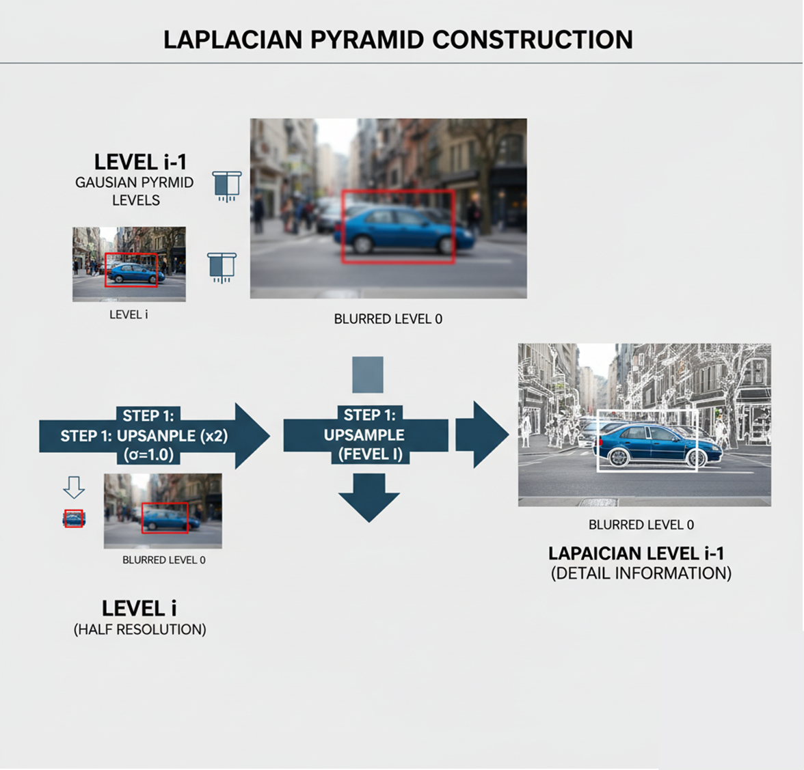
Illustration: Showing how to derive a Laplacian level from two adjacent Gaussian levels, emphasizing the detail information it captures. `

Slide 8
Advantages & Disadvantages of Pyramids:
Advantages: Simple to understand and implement, effectively captures multiscale information.
Disadvantages: Redundancy (Gaussian pyramid), computational cost (Laplacian pyramid reconstruction).

Slide 9
Wavelets
Concept: A mathematical tool that decomposes an image into different frequency components at different scales.
Unlike Fourier Transform (which uses sine/cosine waves of infinite duration), wavelets are localized in both frequency and space.
Analogy: A "mathematical microscope" that can zoom in on details (high frequencies) or zoom out for the overall picture (low frequencies).

Slide 10
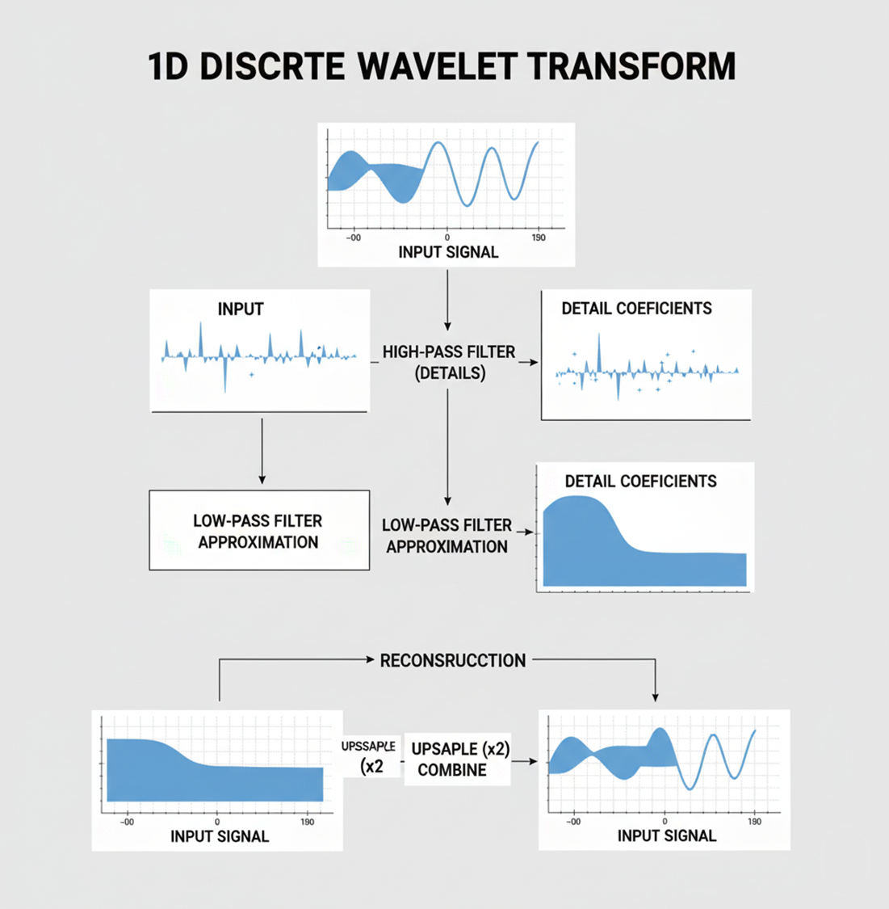
1D Wavelet Transform Intuition:
Low-pass filter (approximation): Captures smooth variations, overall shape.
High-pass filter (details): Captures rapid changes, edges.
Low-pass filter (approximation): Captures smooth variations, overall shape.
Downsampling: Reduces data size.
Illustration: Simple 1D signal decomposed into approximation and detail coefficients.

Slide 11
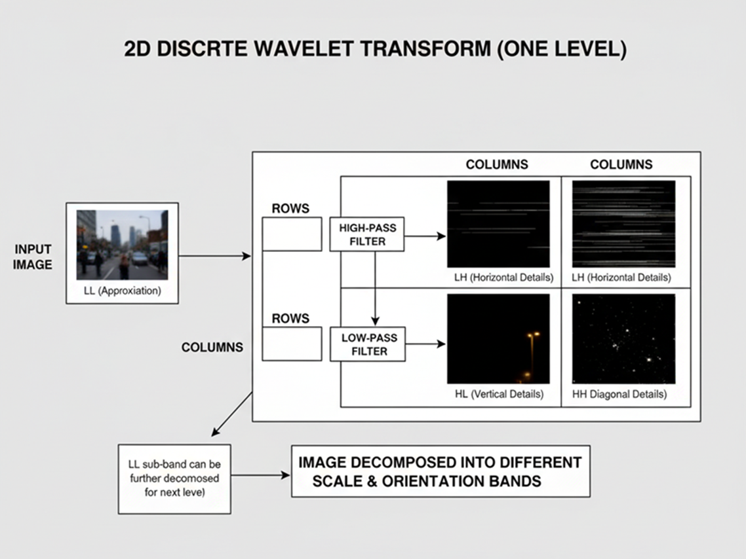
2D Discrete Wavelet Transform
Extension from 1D: Apply 1D transform first to rows, then to columns of the resulting images.
Decomposition into Four Sub-bands (at each level):
LL (Low-Low): Approximation (like a smaller, blurred version of the original)
LH (Low-High): Horizontal details (edges)
HL (High-Low): Vertical details (edges)
HH (High-High): Diagonal details (corners, textures)
Multiresolution: The LL sub-band can be further decomposed to get the next level of resolution.
Illustration: 2D image decomposition showing the LL, LH, HL, HH sub-bands after one level of DWT. `

Slide 12
Advantages of Wavelets
Compact Representation: Often less redundant than Laplacian pyramids.
Spatially and Frequency Localized: Good for analyzing non-stationary signals (like images).
Efficient: Can be computed quickly using filter banks.

Slide 13
Multiscale Representation for Object Detection
The Challenge of Scale in Object Detection:
An object detector trained on a fixed-size input image needs a mechanism to find objects of various sizes in the real world.
Example: A face detector trained on 64x64 pixel faces needs to find a small face (e.g., 30x30 pixels) and a large face (e.g., 120x120 pixels) in an image.

Slide 14
Using Image Pyramids for Object Detection (Sliding Window Approach):
Concept: To detect objects of different sizes, we can resize the image itself rather than resizing the detector.
Process:
Create a Gaussian pyramid of the input image.
Run the object detector (e.g., a trained classifier with a fixed-size window) independently on each level of the pyramid.
A small object in the original image will appear larger at a higher level (lower resolution) of the pyramid, making it detectable by the fixed-size window. A large object will appear at a lower level (higher resolution).
Combine detections from all levels, scaling them back to the original image coordinates.

Slide 15
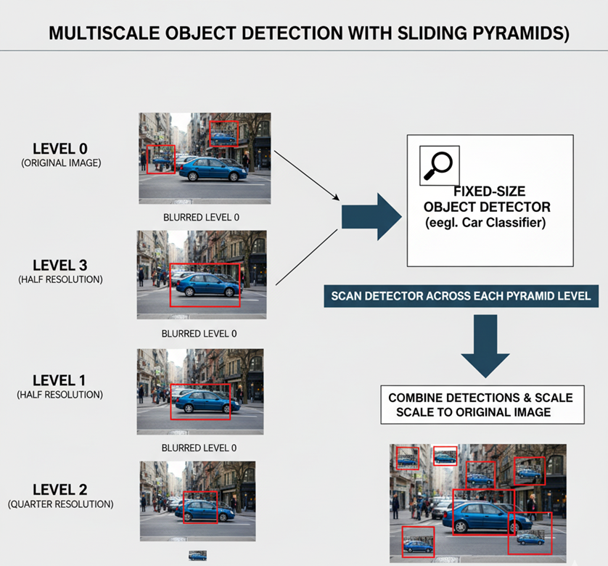
Illustration: A fixed-size detector scanning different levels of a Gaussian pyramid to find objects of varying sizes in the original image. `

Slide 16
Wavelets in Object Detection:
Features extracted using wavelet coefficients can be used as input to classifiers.
Wavelet features are inherently multiscale and capture directional information, which can be robust for detection.
Example: Early face detection systems sometimes used Haar wavelets (simple box filters) as features.
Modern Context : While classical pyramids and wavelets laid the groundwork, modern deep learning architectures often incorporate multiscale processing internally through techniques like feature pyramids (FPNs) or attention mechanisms, building on these foundational concepts.

